Slide 1
THE SCHLIEFFEN PLAN

Slide 2
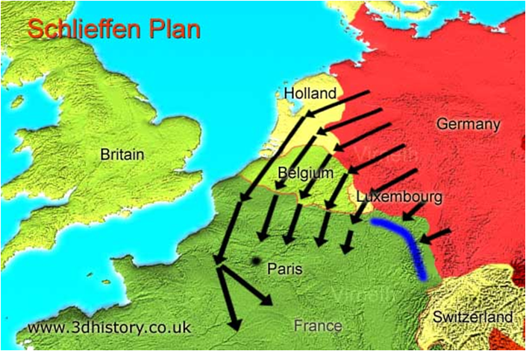

Slide 3
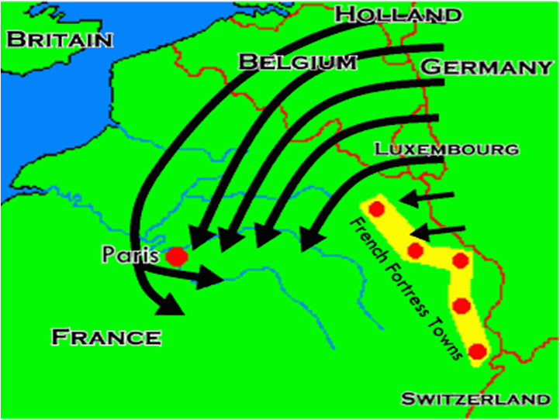

Slide 4
Title: The Schlieffen
PlanObjective: To eliminate France as an ally of Russia during a war with Germany.
Author: Alfred von Schlieffen, German Army Chief of Staff
Timescale: Six Weeks

Slide 5
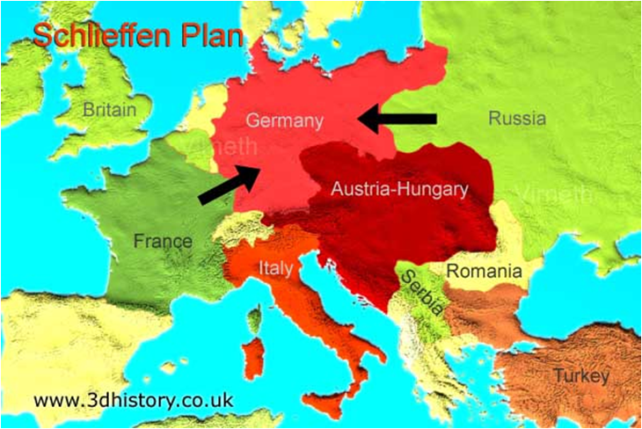

Slide 6
The plan assumed:
Russia would take 6 weeks to mobilise its army.
Belgium would offer little or no resistance.
France could be defeated in 6 weeks.
France would attempt to re-take Alsace and Lorraine; territories they lost to Germany during the Franco-Prussian war.
Britain would remain neutral

Slide 7
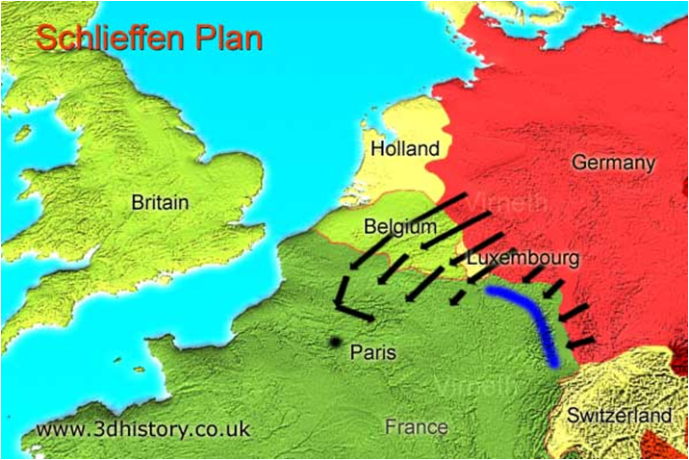

Slide 8
What happened though was:
The advance was held up by the Belgians
The Russians mobilized in just 10 days, not six weeks, so that more troops had to be diverted from the attack on France to defend the eastern border
Britain entered the war on France's side due to an agreement with Belgium to defend her against German attack.
The British Expeditionary Force reached France and Belgium far quicker than expected

Slide 9
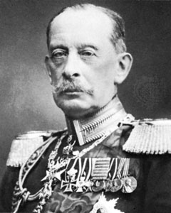
Alfred Graf von Schlieffen

Slide 10
The plan.
Based on speed and surprise.
Idea was to knock France out of WW1 and avoid fighting a war on 2 fronts.
Avoid heavy French defences by going through Belgium.
Germany believed it would take Russia at least 6 weeks to mobilize.

Slide 11
WHY DID IT FAIL?
Germans went through Holland as well as Belgium
Russia mobilized in 3 weeks – using trains.
French used taxi’s to transport their troops to Marne
Germans marched on foot = tired, running out of supplies

