Slide 1
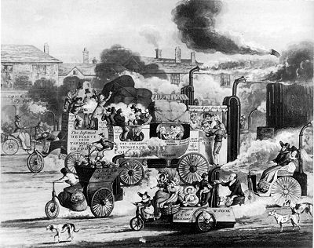
The Industrial
Revolution
The Industrial Revolution spreads through Britain in the 1800’s.
This revolution happened in the 18th century and 19th centuries.
BUT, WHAT WAS IT..???
The industrial revolution was a period of time when people stop working in the domestic system and start working with the Factory System.

Slide 2
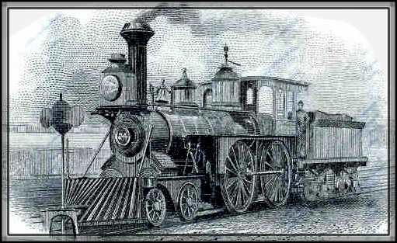
Causes
British Farming improved enough to feed all factory workers
The Population increased, big demand for food and goods
Transport Infrastructure was build to acces the markets
More Banks, people borrowed more money.
People invested money to start new factories

Slide 3
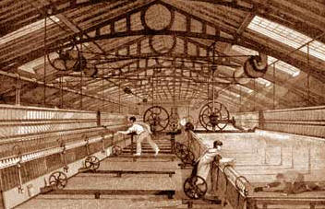
More Causes
New machines invented, people interested in science and technolgy
Large amount of coal to power the steam
Britain Colonies provided raw materials and markets for British goods
The “Laissez-Faire”

Slide 4
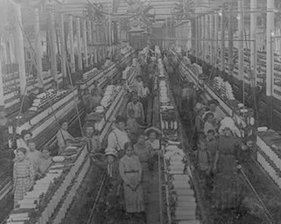
Working Conditions
Women and young people were employed in very bad conditions
They operate the factories without safety. This caused accidents.
They work for a lot of hours (12 or more hours per day) with no holidays.

Slide 5
Did you know that…
...The population in Britain changed to be industrial from being agricultural.
…The Revolution was next spread through Europe.
...During this time, many machines were invented.
…One machine from the factories do what 50 workers do by hand.

Slide 6
Sources:
http://industrialrevolution.sea.ca/causes.html
http://www.woodlands-junior.kent.sch.uk/homework/victorians/industrialrevolution.html
http://www.google.com.pe/url?sa=t&rct=j&q=&esrc=s&frm=1&source=web&cd=7&cad=rja&ved=0CGIQFjAG&url=http%3A%2F%2Fwww.fabiuspompey.org%2Ftfiles%2Ffolder218%2FCauses%2520of%2520the%2520Industrial%2520Revolution2.ppt&ei=bZyEUOegLJGo8QS08YHwCQ&usg=AFQjCNEC9xu-BdTQIIRjO2g99-jKp9Dk0g&sig2=pOJn5GfnfUViiecg3iBtuA
http://www.clemson.edu/caah/history/FacultyPages/PamMack/lec122/britir. htm
http://www.history.com/topics/industrial-revolution
http://thehumanjourney.net/index.php?option=com_content&task=view&id=56&Itemid=110
http://www.saburchill.com/history/chapters/IR/039.html
http://history-world.org/Industrial%20Intro.htm

